Slide 1
Binary Search Tree
Pro Academy I
Data Structure
Notes:
By leonardi.l

Slide 2
Tree Definition
Trees are hierarchial data structures
Unlike Arrays, Linked list, Stack & Queue (Linear data structures)
Trees are commonly constructed using Linked List technique (pointers)

Slide 3
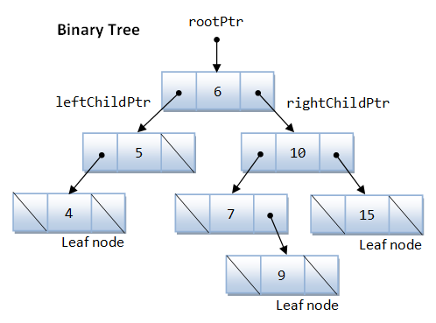
Tree Vocabularies
The topmost element = Root
Elements directly under an element is called its children
Elements directly above something is called its parent
Elements with no children are called leaf

Slide 4
Why Tree?
To represent a hiearchial information
Trees (with ordering of its elements) provide moderate access/search (quicker than LinkedList, slower than Array)
Trees provide moderate insertion/deletion (quicker than Array, slower than LinkedList)
Trees based on LinkedList (pointers), thus has (practically) unlimited capacity

Slide 5
Speed
Algorithm | Average | Worst Case
Space | O(n) | O(n)
Search | O(log n) | O(n)
Insert | O(log n) | O(n)
Delete | O(log n) | O(n)

Slide 6
Binary Tree
A Tree that has special properties :
Its elements may only have at most 2 children
They are referenced (using pointer) as left and right child
struct node {
int data;
struct node *left;
struct node *right;
};

Slide 7
Binary Search Tree (BST)
A Binary Tree that has special properties :
The left child (if any) is always smaller than its parent
The right child (if any) is always bigger (or same) as its parent
Thus making BST search time speed O(log n)

Slide 8
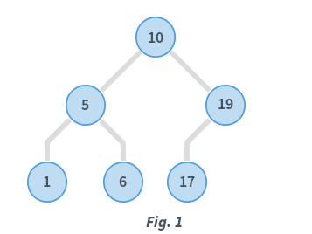
BST (left < right)

Slide 9
BST insert
struct node* insert(struct node* root, int data)
{
if (root == NULL) return newNode(data);
else
{
// recursively traverse to correct leaf
if (data <= root->data)
root->left = insert(root->left, data);
else
root->right = insert(root->right, data);
//return the (unchanged) root pointer
return root;
}
}

Slide 10
BST delete
Node to be deleted is leaf: Simply remove from the tree.
Node to be deleted has only one child: Copy the child to the node and delete the child
Node to be deleted has two children: Find inorder successor of the node. Copy contents of the inorder successor to the node and delete the inorder successor. Note that inorder predecessor can also be used.

Slide 11
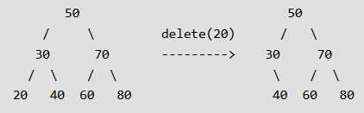
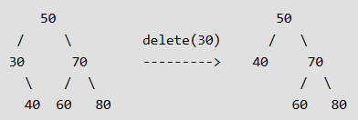
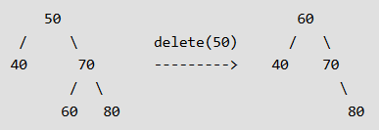
BST delete
Node to be deleted is leaf:
Node to be deleted has only one child:
Node to be deleted has two children:

Slide 12
BST search
struct node* search(struct node* root, int key)
{
// Base Cases: root is null or key is present at root
if (root == NULL || root->key == key)
return root;
// Key is greater than root's key
if (root->key < key)
return search(root->right, key);
// Key is smaller than root's key
return search(root->left, key);
}

